Slide 1
Ch6. Programming for Humans Terminal Control and Signals
ELEC462003 System Programming

Slide 2
Objectives
Ideas and Skills
Reading and changing settings of the terminal driver
Modes of the terminal driver
Nonblocking input
Timeouts on user input
Introduction to signals: How Ctrl-C works
System Calls
fcntl
signal

Slide 3
Device-Specific Programs
Device-Specific Programs : interact with specific devices
Ex: Programs to control scanners and printers, take photographs, and handling some I/O devices
In this chapter, we explore the ideas and techniques of writing device-specific programs by looking at programs that interact with terminals.
Notes:
We refer to these terminal-oriented programs as user programs.

Slide 4
User Programs: A Common Type of Device-Specific Program
Ex:
vi, emacs, and many of the games
These programs adjust settings in the terminal driver to control how keystrokes are handled and output is produced.
Common concerns of user programs using the terminal include:
Immediate response to keys
Immited input set
Timeout on input
Resistance to Ctrl-C
Notes:
We shall learn about these topics by writing a program that implements all these features.
Lynx is a customizable text-based web browser for use on cursor-addressable character cell terminals.
Pine is a freeware, text-based email client

Slide 5
Contents
6.1 Software Tools vs. Device-Specific Programs
6.2 Modes of the Terminal Driver
6.3 Writing a User Program: play-again.c
6.4 Signals
6.5 Prepared for Signals: play_again4.c

Slide 6
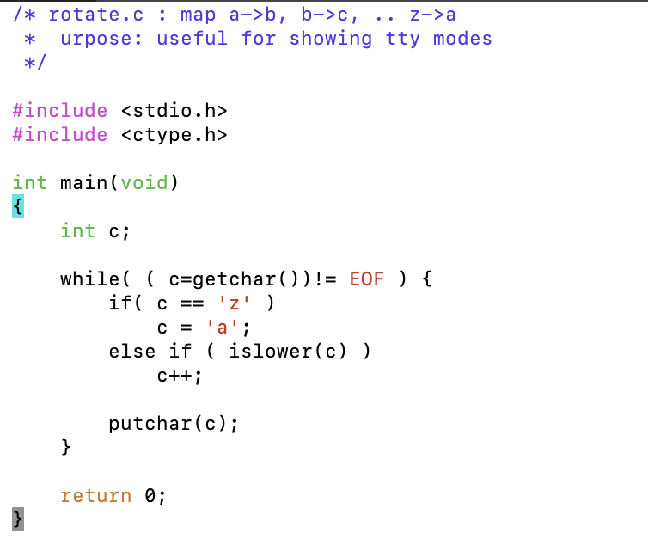
Ex1: A short translation program
Notes:
Explore the driver in detail by experimenting with a shot translation program

Slide 7
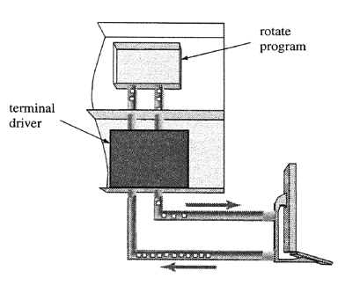
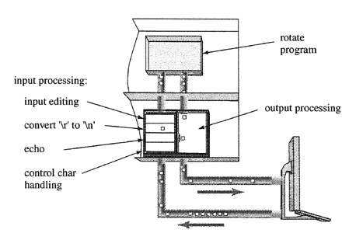
Canonical Mode: Buffering and Editing
Run the program using the default settings:
The rotate program does none of these operation: buffering, echoing, editing, control key processing are all done by the terminal driver
$ gcc rotate.c -o rotate
$ ./rotate
abx ← cd
bcde
efg
$
back space
Ctrl+C
Terminal Driver
Notes:
TeCanonical Mode: Buffering and Editing

Slide 8
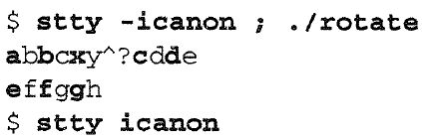
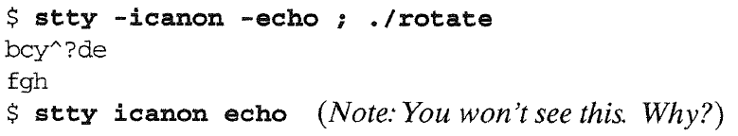
Noncanonical Processing
^C
Turning off canonical mode processing in the driver
Turning off canonical mode processing and echo mode in the driver
Notes:
canonical processing = buffering+ editing

Slide 9
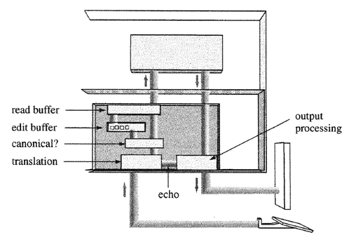

Summary of Terminal Modes
canonical mode
Buffering and editing are turned on
terminal input is processed in lines terminated by newline ( '\n’ ) or EOF (Ctrl+D) characters.
noncanonical mode
Buffering and editing are turned off
But, terminal driver still does specific processing : ^C, \n, \r
non-anything mode : raw mode
When all processing is turned off, the driver passes input directly to the program
Notes:
PKA: an acronym for Previously Known As
※ $ stty –a
… erase = ^? ( or ^H) ; werase = ^W; kill = ^U …
The terminal can be placed into "raw" mode where the characters are not processed by the terminal driver,
but are sent straight through
(it can be set that INTR and QUIT characters are still processed).
This allows programs like emacs and vi to use the entire screen more easily.
※ When you design a user program for Unix, you need to decide which terminal mode matches the application.

Slide 10
Contents
6.1 Software Tools vs. Device-Specific Programs
6.2 Modes of the Terminal Driver
6.3 Writing a User Program: play-again.c
6.4 Signals
6.5 Prepared for Signals: play_again4.c

Slide 11
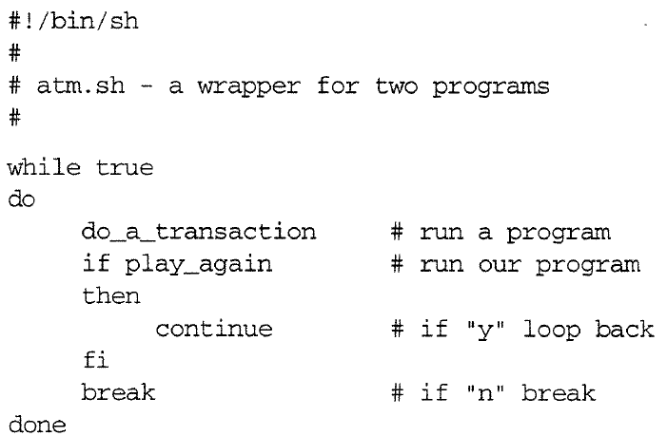

A shell script for a bank machine (ATM)
does the work of the ATM
obtains a yes or no answer from the user
Notes:
fi : endif in shell
A shell script is a computer program designed to be run by the Unix shell, a command-line interpreter.

Slide 12
Ex2: play_again.c
It obtains a yes or no answer from the user
The logic:
Prompt user with question
Accept input
If “y”, return 0
If “n”, return 1

Slide 13
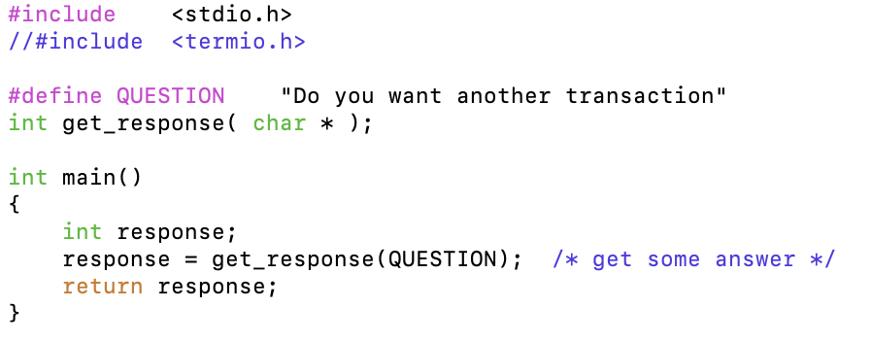
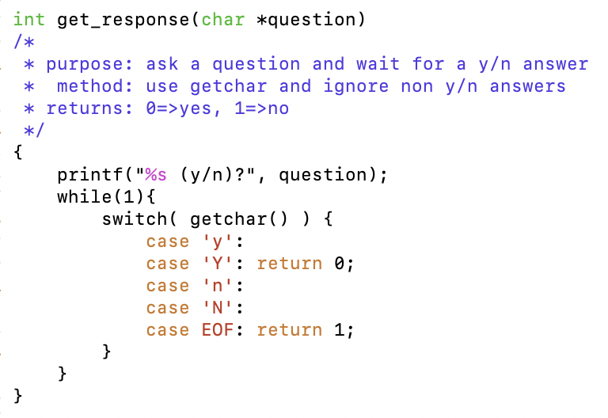
Ex2: play_again0.c
It obtains a yes or no answer from the user

Slide 14
Ex2: play_again0.c
Two Problems caused by running in canonical mode
User has to press the Enter key
Program receives and processes an entire line of data when the user presses Enter.
First improvement: Turning off canonical input

Slide 15
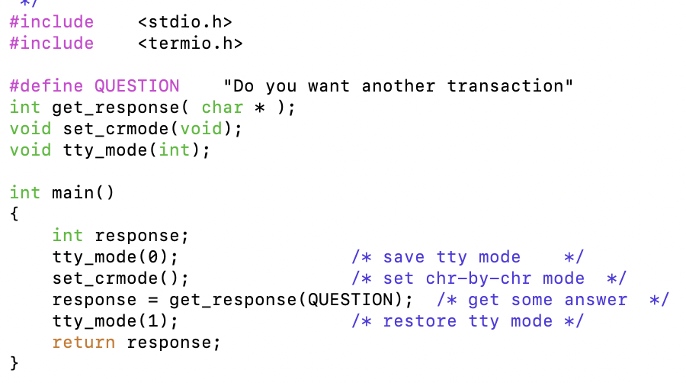
Ex3: play_again1.c – immediate response

Slide 16
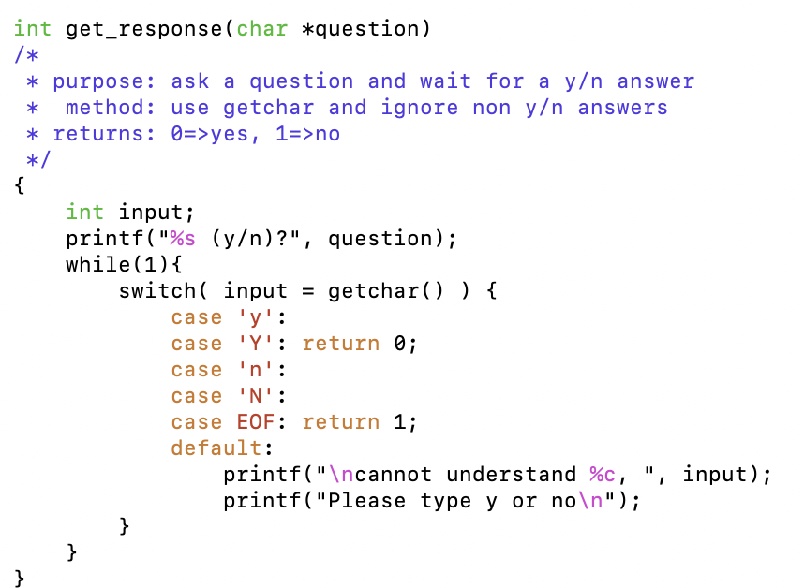
Ex3: play_again1.c – immediate response

Slide 17
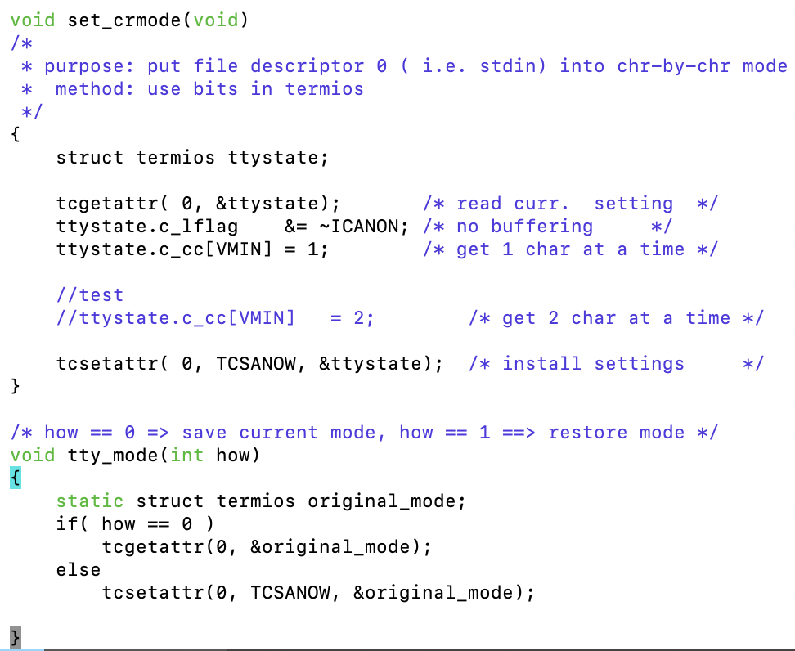
Ex3: play_again1.c – immediate response
// “c_cc” member : the control character array
// VMIN : tells the driver how many characters at a time we are reading

Slide 18
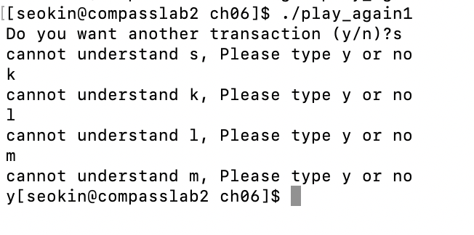
Ex3: play_again1.c – immediate response
$ gcc play_again1.c –o play_again1
play_again1 receives and processes characters as they are typed without waiting for the Enter key!
Notes:
play_again1 receives and processes characters as they are typed without waiting for the Enter key!

Slide 19
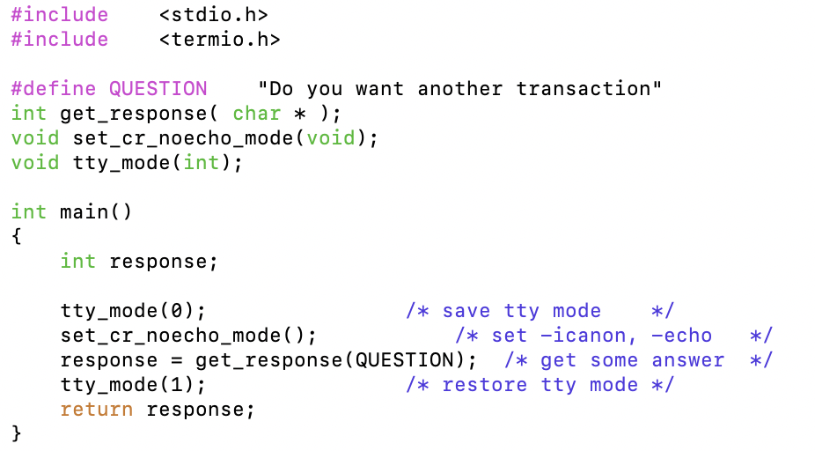
Ex4: play_again2.c – ignore illegal keys
Notes:
complaining about every character is annoying
turn off echo mode and discard characters until we get accetable input

Slide 20
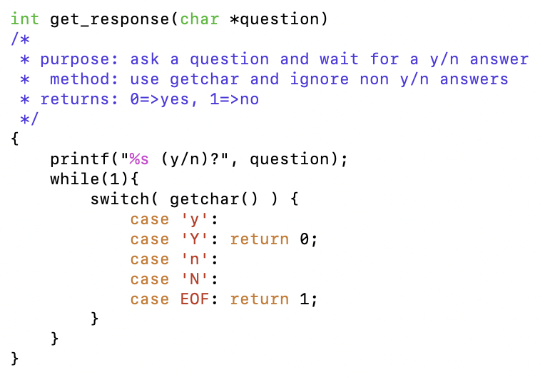
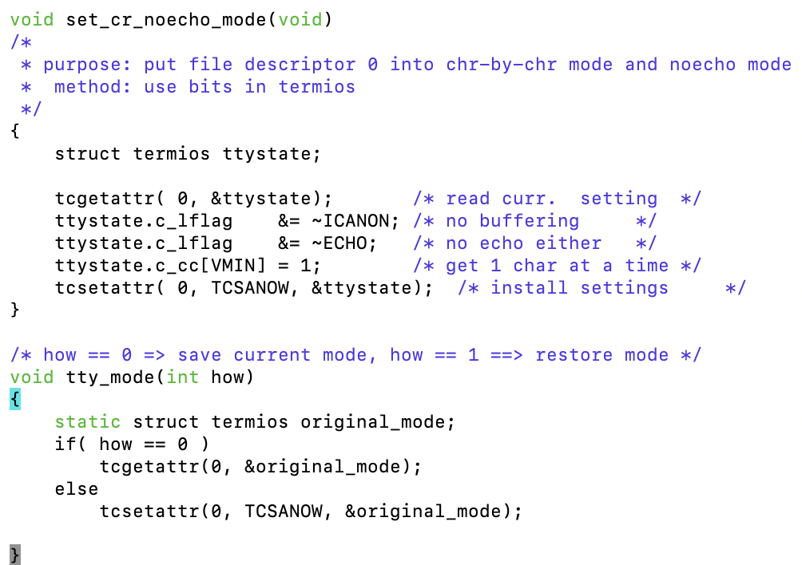
Ex4: play_again2.c – ignore illegal keys
Notes:
complaining about every character is annoying
turn off echo mode and discard characters until we get accetable input

Slide 21
Ex4: play_again2.c – ignore illegal keys
Compile and try this program: (no echo)
Only when you press ”y” or “n” does the program return.
It needs one more feature;
What if this program were used at a real ATM and a customer wandered away without pressing y or n?
User programs are more secure when they include a timeout feature.

Slide 22
Nonblocking Input: play_again3.c
We create this timeout feature by telling the terminal driver not to wait for input.
If a program find no input, it sleeps a few seconds then look again for input.
After three tries, the program give up

Slide 23
Blocking vs. Nonblocking Input
When a program call getchar() or read() to read data from a file descriptor, the call waits for input: blocked
How do we turn off input blocking?
Use fcntl() or open() to enable nonblocking input for a file descriptor.
Internally, nonblocking operation is pretty simple.
Each file has a space to hold available unread data, inside the driver.
If the fd has the O_NDELAY bit set and that space is empty, the read() returns 0.
Notes:
* fcntl : manipulate fd
* Blocking is a property of any open file, not only connections to the terminals
We turn off blocking on a file descriptor and call read()
If input is available, read() gets it and returns the number of characters it got.
If no characters are available, read() returns 0, just as it does at end of file.
If there is an error, read() returns -1
Internally, nonblocking operation is pretty simple.
Each file has a space to hold available unread data, inside the driver.
If the file descriptor has the O_NDELAY bit set and that space is empty, the read()returns 0.

Slide 24
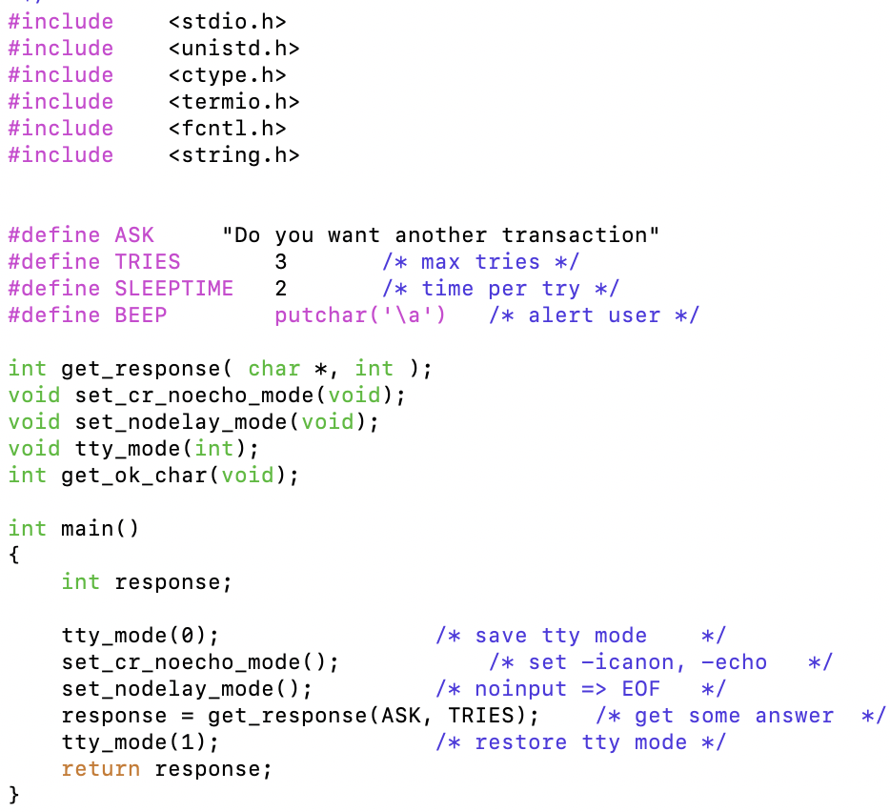
Ex5: play_again3.c – use nonblocking mode for timeouts
Notes:
Play_again3 uses fcntl to turn on the O_NDELAY flag for the file descriptor.
(You can use the O_NONBLOCK bit.)

Slide 25
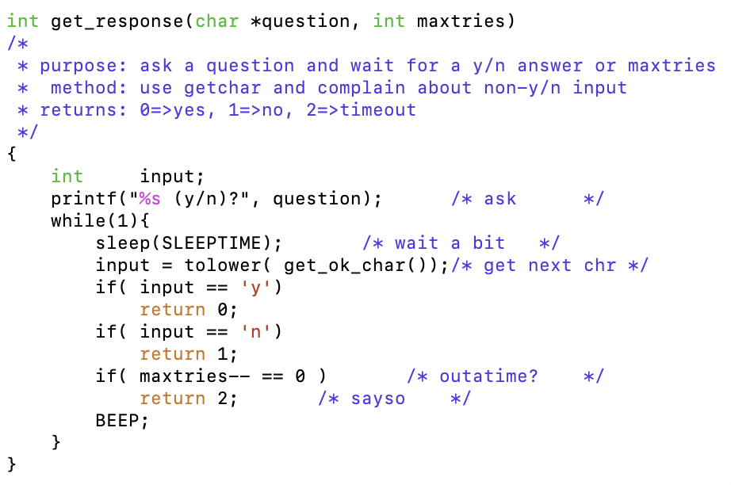
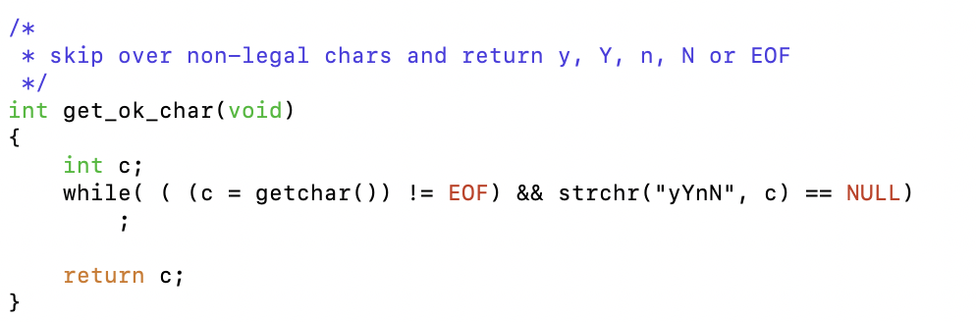
Ex5: play_again3.c – use nonblocking mode for timeouts
※ returns a pointer to the first occurrence of the character c in the string s
Notes:
Play_again3 uses fcntl to turn on the O_NDELAY flag for the file descriptor.
(You can use the O_NONBLOCK bit.)

Slide 26
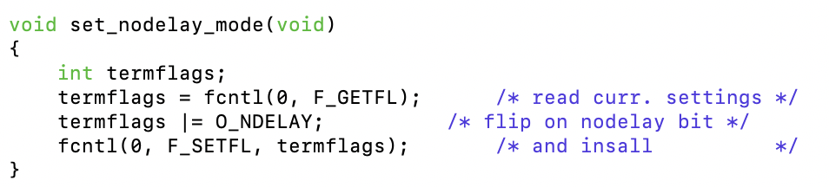
Ex5: play_again3.c – use nonblocking mode for timeouts

Slide 27
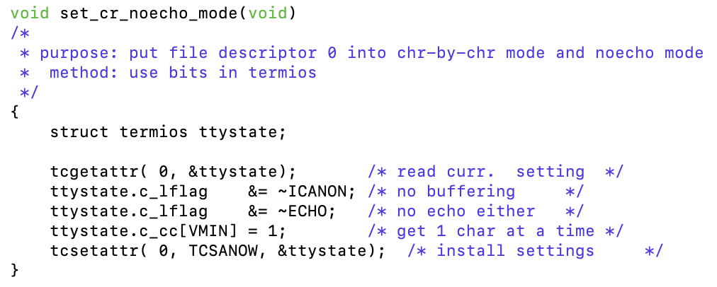
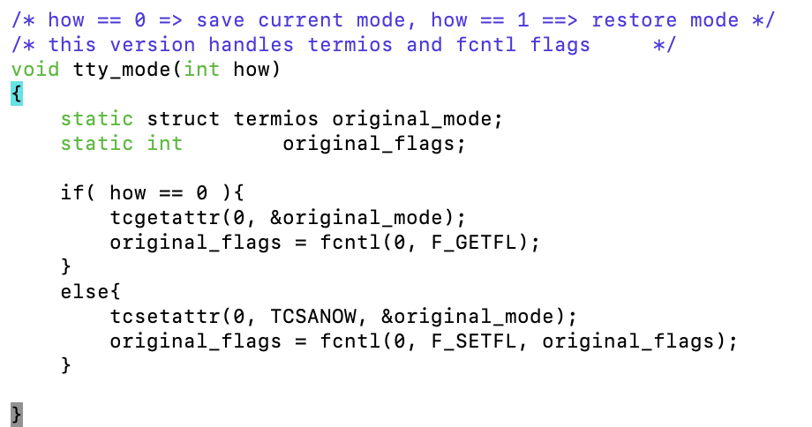
Ex5: play_again3.c – use nonblocking mode for timeouts

Slide 28
Ex5: play_again3.c – use nonblocking mode for timeouts
Small Problems with play_again3:
The program sleeps for two seconds before calling getchar() to give the user a chance to type something.
If the user types within one second,
The program does not get the character until two seconds pass
Without the call to fflush() after printing the prompt, the prompt does not appear until the program calls getchar();
Why?
The driver buffers output until it receives a newline or until the program tries to read from the terminal
Notes:
The driver also line-buffer output;
The driver buffers output until it receives a newline or until the program tries to read from the terminal.
fflush: If the given stream was open for writing
any unwritten data in its output buffer is written to the file.

Slide 29
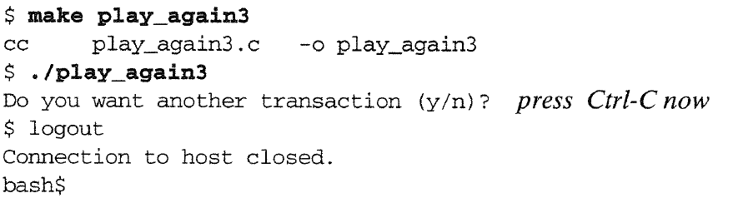
Ex5: play_again3.c – use nonblocking mode for timeouts
A Big Problem: What happens if the user presses Ctrl-C?
※ The program is killed and
the entire login session is also killed!

Slide 30
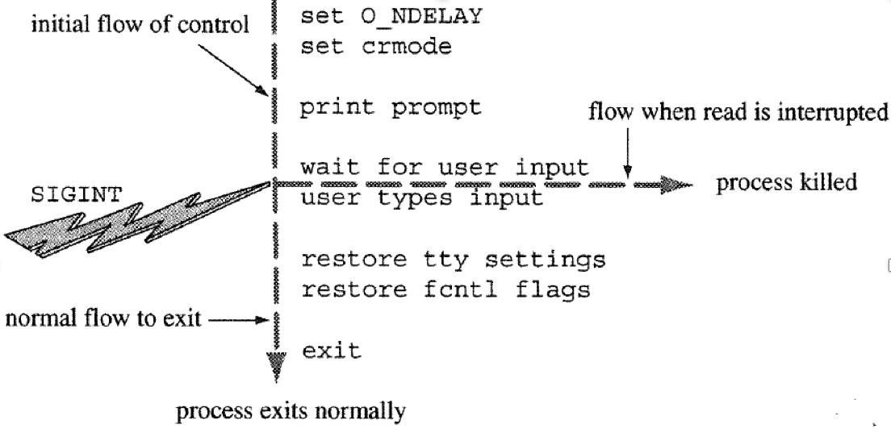
Ex5: play_again3.c – use nonblocking mode for timeouts
How did it happen?
The program is killed without restoring the state of the terminal driver
The terminals still in nonblocking mode when the shell returns to print its prompt and get a command line from the user.
The shell calls read() to get the command line, but read(), operating in nonblocking mode, returns 0 immediately
How to protect our program from Ctrl-C?
Notes:
The terminals still in nonblocking mode when the shell returns to print its prompt and get a command line from the user.
The shell calls read to get the command line, but read, operating in nonblocking mode, returns 0 immediately.

Slide 31
Contents
6.1 Software Tools vs. Device-Specific Programs
6.2 Modes of the Terminal Driver
6.3 Writing a User Program: play-again.c
6.4 Signals
6.5 Prepared for Signals: play_again4.c
Notes:
Next project : How to protect our program from Crtl-C?
Ctrl-C interrupts the current running pg.
This interruption is produced by a kernel mechanism, called signal

Slide 32
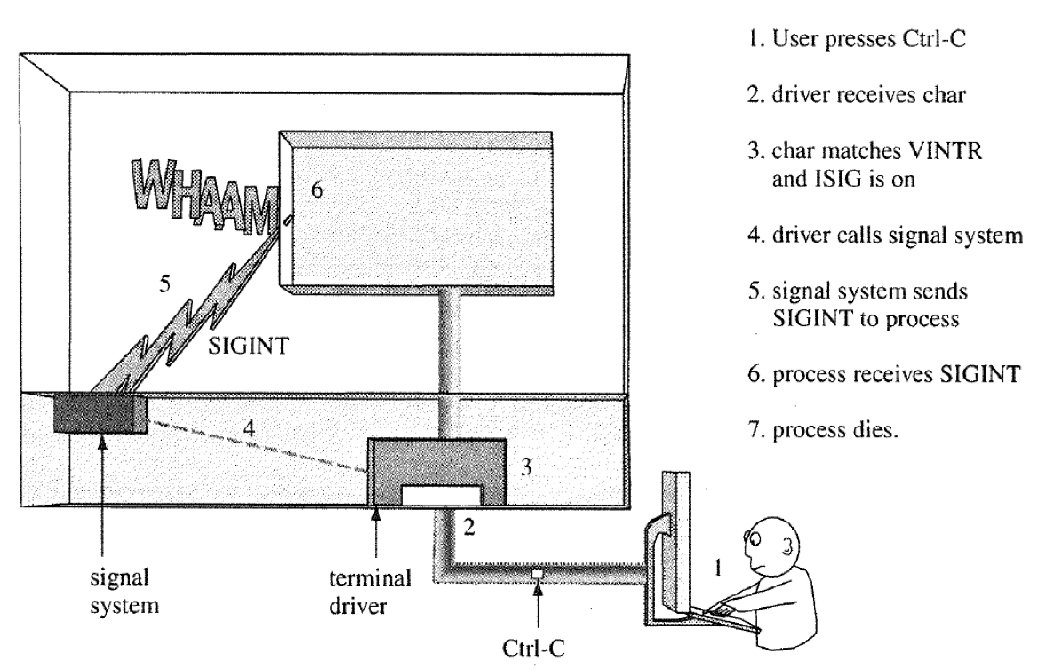
What Does Ctrl-C Do?
The Ctrl-C key interrupts the currently running program
This interruption is produced by a kernel mechanism called a signal
Notes:
Ctrl-C key interrupts the currently running pg. This interruption is produced by a kernel mechanism called a "signal“
VINTR (003, ETX, Ctrl-C, or also 0177, DEL, rubout) Interrupt character (INTR).
Send a SIGINT signal. Recognized when ISIG is set, and then not passed as input.
Ctrl-C interrupts the current running pg. This interruption is produced by a kernel mechanism, called signal

Slide 33
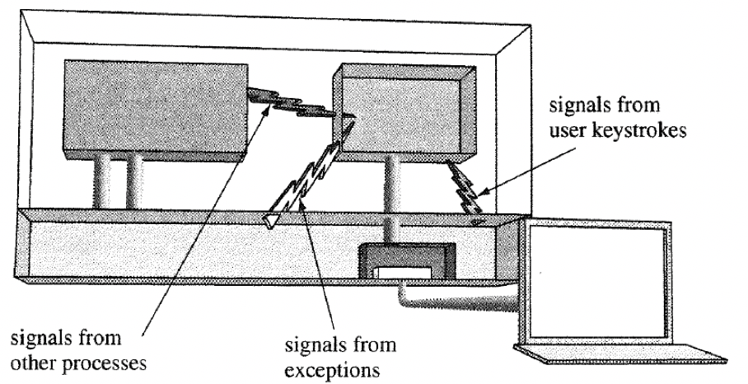
What is a Signal?
A signal is a one-word message from kernel to process
Each signal has a numerical code (e.g., interrupt signal is code number 2)
When pressing the Ctrl-C key, kernel send the interrupt signal to the currently running process
Requests for signals come from three sources :
Signals from user, ex) when user press Ctrl-C key
Signals from kernel, ex) when the process does something wrong such as process exception and segmentation violation
Signals from other processes, ex) a process can send a signal to communicate with other processes
Notes:
Ctrl+C : u ask the kernel to send the interrupt signal to the current running process
A signal is a short message sent from the kernel to a process. Users, other processes, and the kernel itself may request a signal.

Slide 34
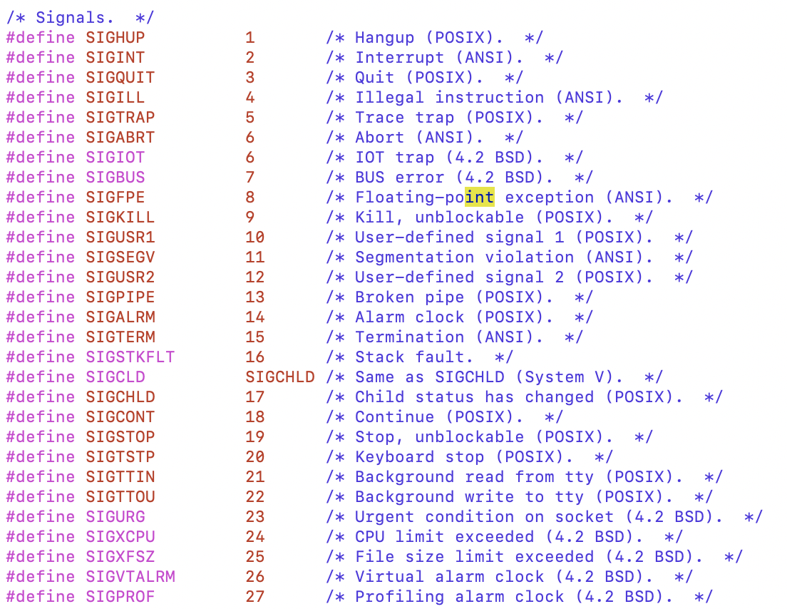
Where Can I Find a List of Signals?
/usr/include/bits/signum.h
Notes:
What do signals do? It depends. Many signals causes processes to die.

Slide 35
What Can a Process Do about a Signal?
A process does not have to die when it receives SIGINT
A process can tell the kernel by using the signal(), how it wants to respond to a signal
A process has three choices:
Accept the default action (usually death) signal(SIGINT, SIG_DFL);
Ignore the signal signal(SIGINT, SIG_IGN);
Call a function signal(signum, functionname);
Notes:
a process does not have to die when it receives SIGINT
Does not have to use signal to accept the default, but a process can reset the default action with

Slide 36
Signal Handling
Signal
Purpose | Simple signal handling
Include | #include <signal.h>
Usage | return = signal (int signum, void (*actin)(int))
Args | signum : the signal to respond to action : how to respond
Returns | -1 : if error preaction. : if success
Notes:
The play_again3 program would be better if, upon receiving SIGINT, it called a function to restore settings and then exit().
To install a signal handler, a program calls signal(signum, functionname);
signal(signum, functionname); call allows exactly this sort of response

Slide 37
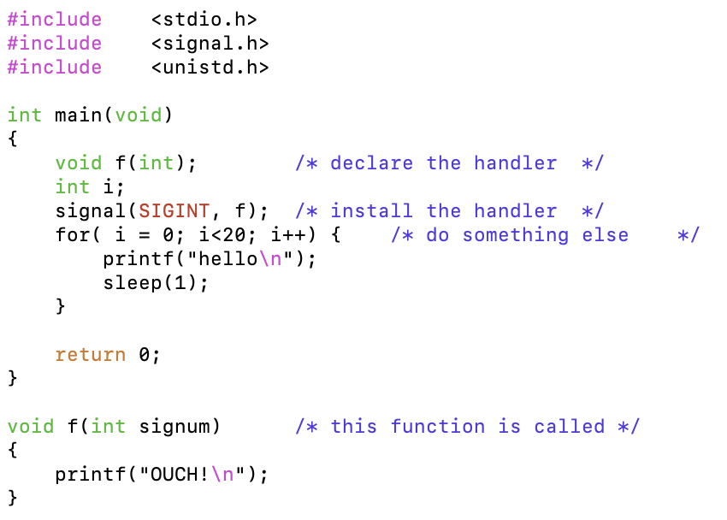
Example of Signal Handling
Ex 6: Catching a Signal

Slide 38
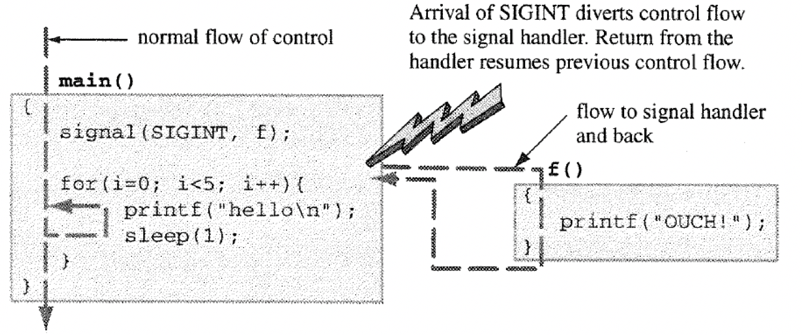
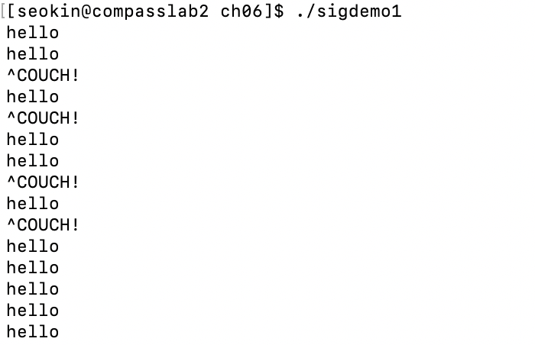
Example of Signal Handling

Slide 39
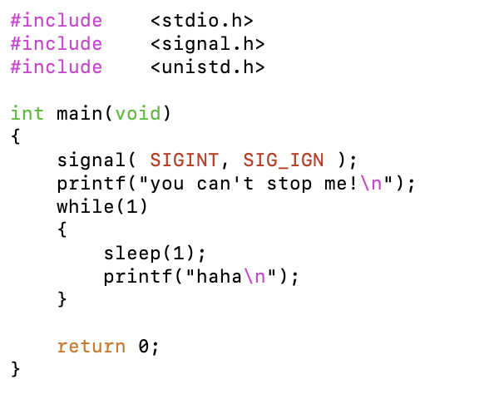
Example of Signal Handling
Ex 7: Ignoring a Signal

Slide 40
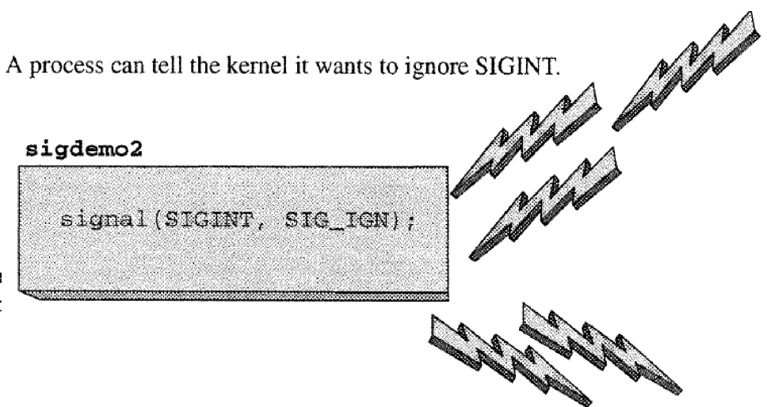
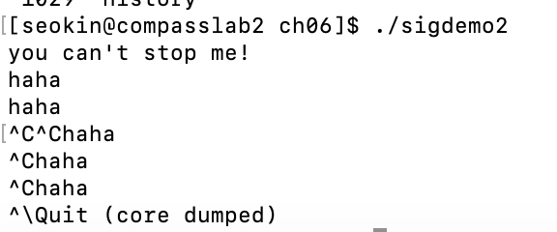
Example of Signal Handling
Interrupt signals (Ctrl + C)
QUIT signals (Ctrl + \)

Slide 41
Contents
6.1 Software Tools vs. Device-Specific Programs
6.2 Modes of the Terminal Driver
6.3 Writing a User Program: play-again.c
6.4 Signals
6.5 Prepared for Signals: play_again4.c

Slide 42
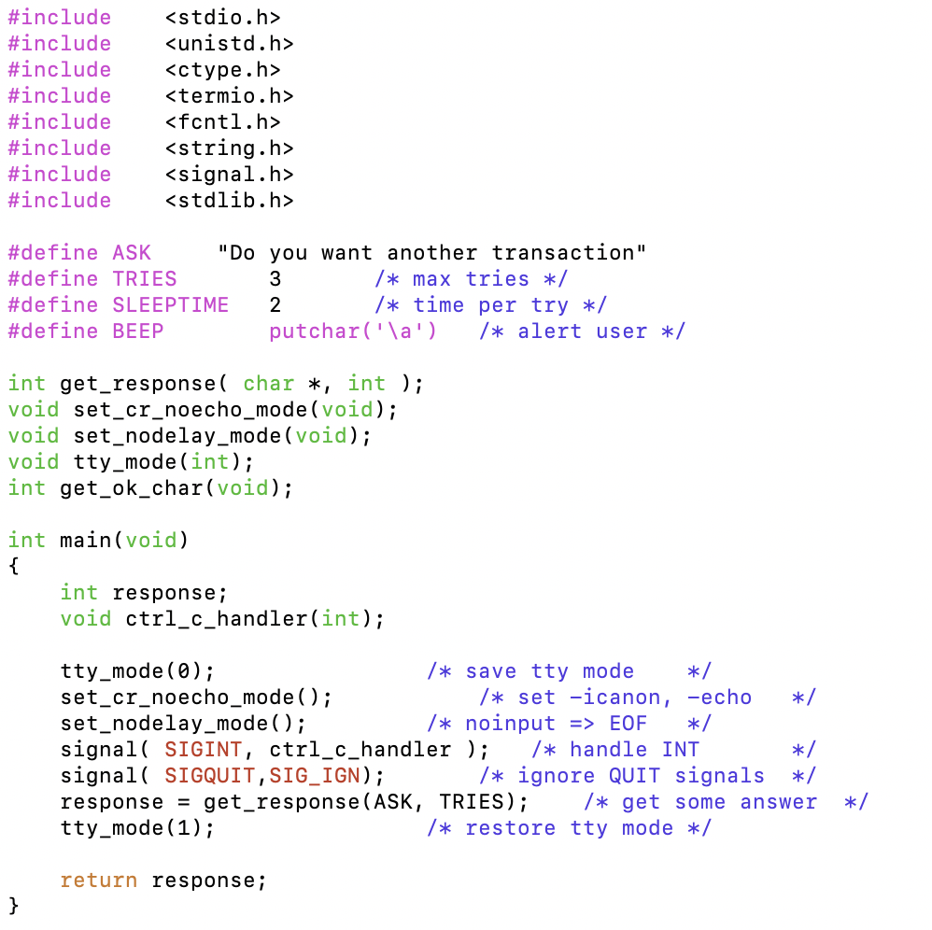
Ex 8: play_again4.c
Notes:
It catches the keyboard signals and exits as if the user typed no.

Slide 43
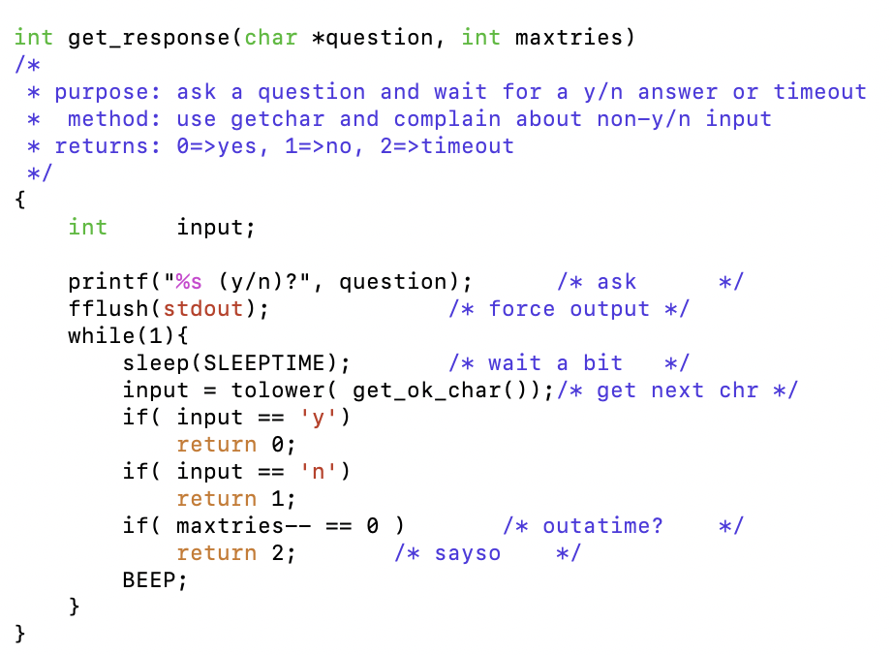
Ex 8: play_again4.c

Slide 44
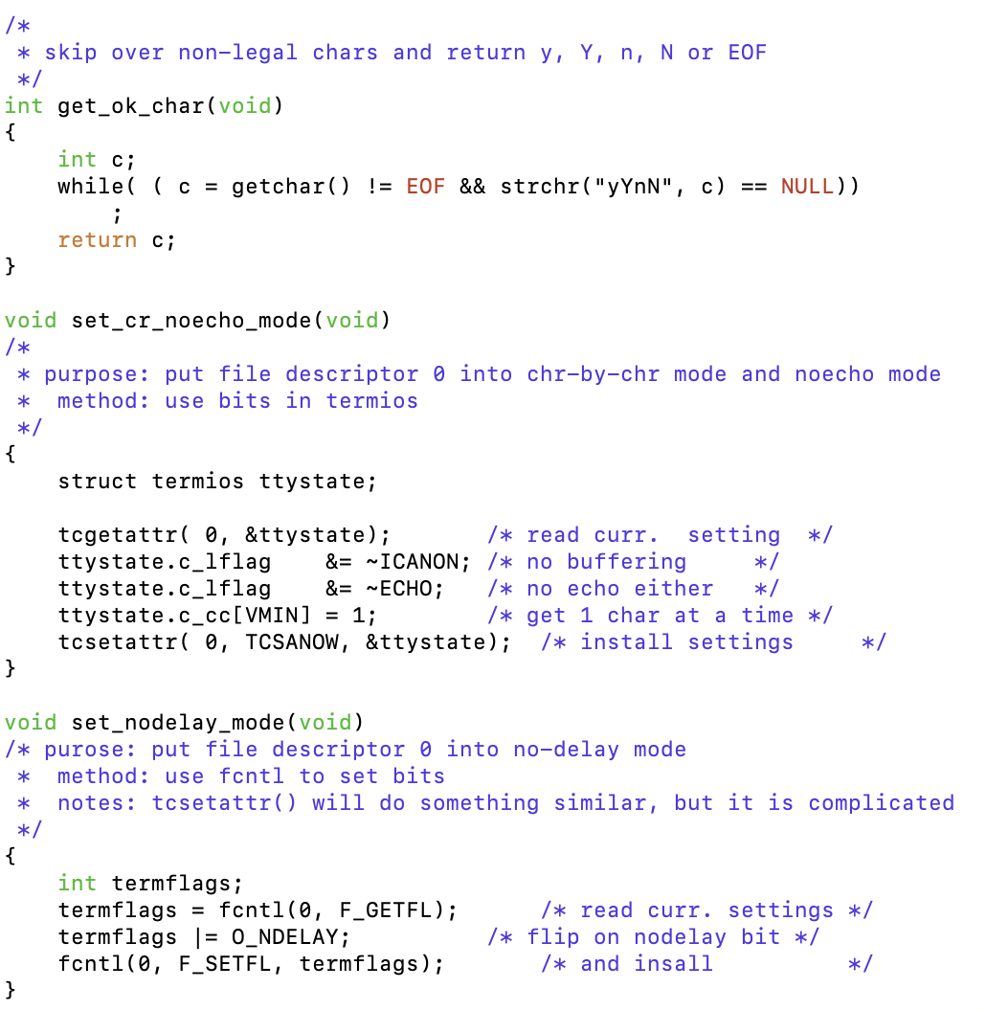
Ex 8: play_again4.c

Slide 45
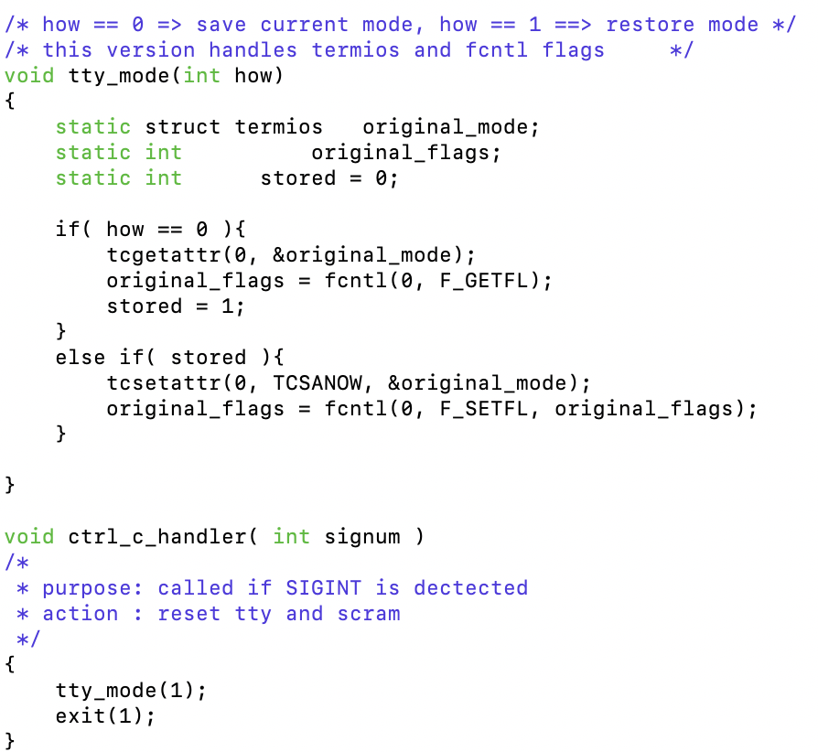
Ex 8: play_again4.c

Slide 46
Summary
Some programs process data from specific devices. These device-specific programs have to control the connection to the device.
Terminal driver has many settings. A collection of setting is called a mode of the terminal driver. Programs for users often set the mode of the terminal driver.
A signal is a short message sent from the kernel to a process. Users, other processes, and the kernel itself may request a signal. A process tells the kernel how it wants to respond when it receives a signal.

